Slide 1

Building Safe Ark Together
Presented by
Masha Apostolidu Safeguarding Lead
Edward Otieno Safeguarding Trustee
Gemma Carder Safeguarding Deputy Lead

Slide 2
Introduction
Safeguarding in the context of the Ark Mission
How safeguarding is relevant to me?
Know the team and support available
Reporting safeguarding concerns
Notes:
How presentation will benefit audience: Adult learners are more interested in a subject if they know how or why it is important to them.
Presenter’s level of expertise in the subject: Briefly state your credentials in this area, or explain why participants should listen to you.

Slide 3
Session 1: Agenda
Safer working practices
Safeguarding team
Safeguarding resources
Recognising, recording and reporting safeguarding concerns
Q&A
Notes:
Example objectives
At the end of this lesson, you will be able to:
Save files to the team Web server.
Move files to different locations on the team Web server.
Share files on the team Web server.

Slide 4

Safeguarding Training for Church Leaders
Central Role of Safeguarding
  Safeguarding is at the heart of church leadership, clarifying roles and responsibilities to protect the community.
Supportive Framework
  Safeguarding provides clarity and accountability, supporting both leadership and pastoral care effectively.
Safeguarding Lead's Role
  The Safeguarding Lead offers guidance and ensures concerns are addressed following agreed procedures.
Creating a Safe Culture
  Embedding safeguarding into daily decisions fosters a safer environment for children and vulnerable adults.
Notes:
This training session is designed to bring safeguarding to the centre of leadership practice within the church. Its purpose is to clarify roles, reduce confusion between safeguarding and pastoral care, and ensure that all leaders understand their shared responsibility to act when concerns arise. Safeguarding is not a criticism of leadership or pastoral ministry; rather, it is a framework that supports both by providing clarity, accountability, and protection. The training acknowledges the relational nature of church life, where trust, prayer, and pastoral care are central, while also emphasising that good intentions alone are not sufficient to keep people safe. By engaging with this training, leaders are encouraged to reflect honestly on current practice, recognise potential gaps, and commit to consistent use of the safeguarding policy. The session also aims to reinforce the role of the Safeguarding Lead as a key point of guidance and support, ensuring that concerns are handled appropriately and in line with agreed procedures. Ultimately, this training seeks to foster a culture where safeguarding is understood, valued, and embedded into everyday leadership decisions, creating a safer environment for children, vulnerable adults, and the wider church community.

Slide 5

The Importance of Safeguarding
Protecting Vulnerable People
  Safeguarding protects children, young people, vulnerable adults, and church leaders from harm and abuse.
Legal and Moral Responsibility
  Safeguarding is a legal and moral duty that ensures accountability and aligns with the church’s values.
Preventing Harm and Escalation
  Effective safeguarding prevents harm, responds promptly to concerns, and reduces risk of escalation.
Building Trust and Accountability
  Good safeguarding builds trust within the church and community by prioritizing safety and clear procedures.
Notes:
Safeguarding matters because it is fundamentally about protecting people from harm. Within a church context, this includes children, young people, vulnerable adults, and also those who serve in leadership and ministry roles. Safeguarding is a legal responsibility, meaning that failure to act appropriately can have serious consequences for individuals and for the church as an organisation. Beyond legal obligations, safeguarding is a moral and spiritual responsibility that aligns with the church’s calling to care for the vulnerable and act with integrity. When safeguarding is taken seriously, it helps to prevent harm, ensures that concerns are responded to promptly, and reduces the likelihood of situations escalating. It also protects leaders by providing clear procedures to follow, reducing the risk of personal blame or misjudgement. Additionally, good safeguarding practice builds trust within the church and with the wider community, demonstrating that safety and accountability are priorities. This slide reinforces that safeguarding is not an administrative burden but a vital part of faithful leadership and responsible ministry.

Slide 6

Understanding the Difference
Nature of Pastoral Care
  Pastoral care provides spiritual and emotional support, relying on trust and confidentiality within informal settings.
Role of Safeguarding
  Safeguarding ensures protection from harm through clear policies and procedures, prioritizing safety in risk situations.
Importance of Distinction
  Recognizing the difference between pastoral care and safeguarding is vital to prevent risks and ensure concerns are escalated properly.
Leadership Responsibility (Elders, Pastors, Team/Group Leaders)
  Church leaders must skillfully identify when safeguarding is needed to protect the community alongside pastoral care.
Notes:
One of the most common challenges in church settings is confusion between safeguarding and pastoral care. Pastoral care focuses on spiritual, emotional, and relational support. It is often informal, flexible, and rooted in trust and confidentiality. Safeguarding, on the other hand, is concerned with protection from harm and follows defined procedures and policies. While pastoral care and safeguarding are closely connected, they are not interchangeable. Safeguarding must always take priority where there is risk, harm, or abuse, even if pastoral support is also needed. This distinction is crucial because relying solely on pastoral responses can unintentionally leave people at risk or result in concerns not being escalated appropriately. Leaders must understand that safeguarding processes exist to support pastoral care, not undermine it. Recognising when a situation moves beyond pastoral support into safeguarding territory is a key leadership skill and an essential part of protecting the church community.

Slide 7

Key Safeguarding Principle
Broad Safeguarding Scope
  All risks, harm, or abuse are safeguarding matters, including vague or historic concerns.
Leaders’ Role in Safeguarding
  Leaders should not assess severity but prioritize safety and refer concerns appropriately.
Prioritizing Safety Over Uncertainty
  Erring on the side of caution reduces missed warnings and ensures proper handling.
Confidence Through Clarity
  Clear safeguarding principles help leaders act confidently and consistently in concerns.
Notes:
A simple and helpful principle underpins effective safeguarding practice: if there is any risk, harm, or abuse, it is a safeguarding matter. This includes concerns that are historic, disclosures that seem vague, or situations where someone feels unsafe but cannot fully explain why. Leaders are not expected to assess severity or decide whether something is ‘serious enough’. That responsibility sits within the safeguarding process itself. This principle encourages leaders to err on the side of caution and to prioritise safety over discomfort or uncertainty. By consistently applying this rule, the church reduces the risk of missed warning signs and ensures that concerns are handled by those with the appropriate responsibility and guidance. This clarity helps leaders act confidently and consistently when concerns arise.

Slide 8
Safer working practice – Recognise harm
Types of harm – Adults
Physical abuse
Domestic violence and abuse
Sexual abuse
Psychological or emotional abuse
Financial or material abuse
Modern slavery
Discriminatory abuse
Organisational abuse
Neglect and acts of omission
Self-neglect
Types of harm – Children
Physical abuse
Domestic violence and abuse
Sexual abuse
Psychological or emotional abuse
Neglect
Grooming
Online abuse
Non-recent abuse
Bullying and cyber-bullying
Notes:
Lesson descriptions should be brief.

Slide 9

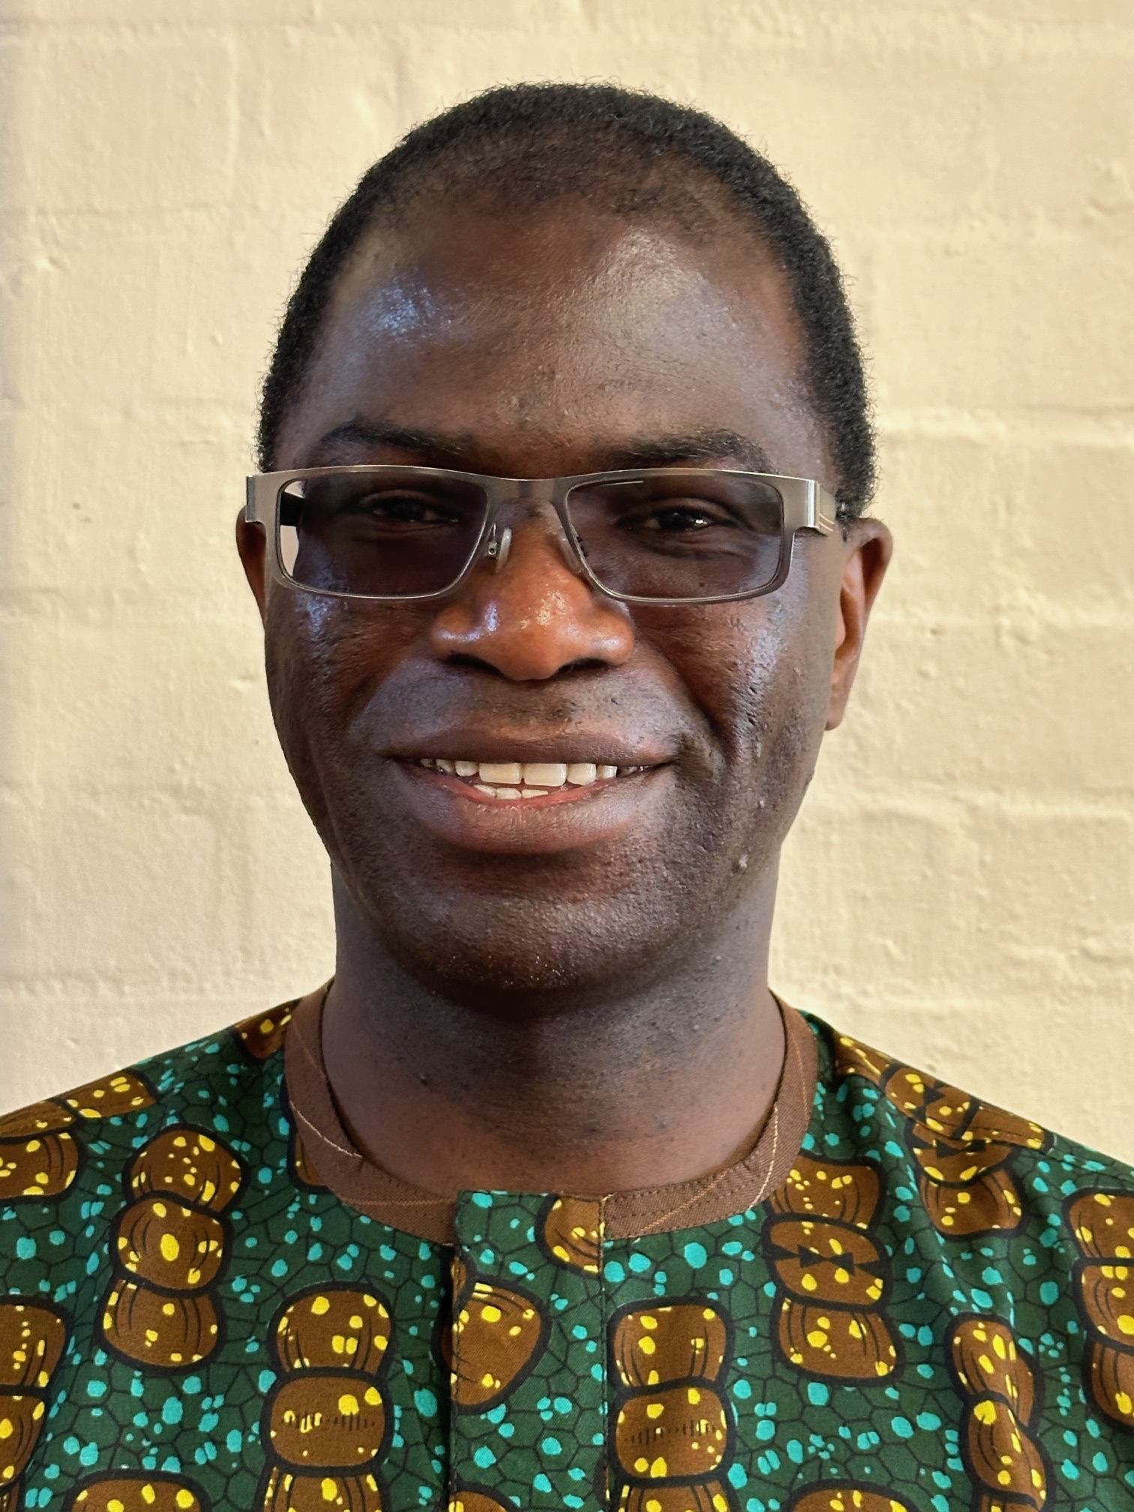

Meet the Safeguarding Team
Safeguarding Lead:
Masha Apostolidu
Role: oversee preparation,
Review and Implementation
of the policies, Recruitment,
reporting SG concerns
Safeguarding trustee:
Edward Otieno
Role: follow guidance and
legislation, report serious
incidents to Charity Commission
Safeguarding Deputy:
Gemma Carder
Role: assists Safeguarding Lead
In all matters od Safeguarding

Slide 10

Role of the Safeguarding Lead
Central Contact for Concerns
  The Safeguarding Lead is the primary contact for reporting and addressing safeguarding issues in the church.
Risk Assessment and Policy Compliance
  They assess risks, ensure safeguarding policies are followed, and maintain accurate records.
Collaboration with External Agencies
  The Lead liaises with outside organizations when necessary to ensure a thorough safeguarding response.
Supporting Pastoral Care
  They support church leadership by providing expertise and consistent safeguarding oversight.
Notes:
The Safeguarding Lead plays a central and essential role in the life of the church. They are the first point of contact for all safeguarding concerns and are responsible for providing guidance on next steps. This includes assessing risk, ensuring the safeguarding policy is followed, maintaining appropriate records, and liaising with external agencies when necessary. The Safeguarding Lead does not replace pastoral care or leadership but supports it by offering expertise and oversight. Involving the Safeguarding Lead early ensures that concerns are managed consistently and appropriately, reducing risk and uncertainty for everyone involved. Leaders should view the Safeguarding Lead as a partner in safeguarding, not as an optional extra or last resort.

Slide 11

Role of Leaders, Pastor, and Elders
Trusted First Responders
  Church leaders are trusted confidants who listen carefully and promptly refer safeguarding concerns to the appropriate lead.
Maintaining Role Boundaries
  Leaders avoid investigating or making confidentiality promises and do not handle safeguarding concerns independently.
Pastoral Support and Guidance
  Pastors and elders provide ongoing spiritual guidance, prayer, and emotional support to the congregation.
Modeling Safeguarding Culture
  Leaders set the tone by modeling good safeguarding practices, fostering safety and accountability within the church community.
Notes:
Church leaders, including pastors and elders, have a vital role in safeguarding. They are often the first to hear concerns and are trusted by members of the congregation. Their responsibility is to listen carefully, avoid investigating or making promises of confidentiality, and refer concerns promptly to the Safeguarding Lead. Pastors and elders continue to provide pastoral support, prayer, and spiritual guidance, but must not manage safeguarding concerns independently. Clear boundaries between roles protect both those at risk and those in leadership. When leaders model good safeguarding practice, they set the tone for the whole church and help embed a culture of safety and accountability.

Slide 12
Safeguarding Process and Policy
Notes:
What To Do When a Concern Arises, Using the Safeguarding Policy

Slide 13

What To Do When a Concern Arises
Listen Calmly and Respectfully
  Allow the person to share their concern without interruption or judgement to show respect and build trust.
Record Accurate Facts
  Document key details promptly using the person’s own words wherever possible to ensure accuracy.
Do Not Promise Confidentiality
  Explain that information may need to be shared to keep people safe, avoiding false confidentiality promises.
Contact Safeguarding Lead
  Immediately seek guidance from the Safeguarding Lead without attempting to investigate or resolve the issue yourself.
Notes:
When a safeguarding concern arises, there are clear steps that leaders must follow. First, listen calmly and respectfully, allowing the person to share without interruption or judgement. Second, record basic facts as soon as possible, using the person’s own words where appropriate. Third, do not promise confidentiality, as information may need to be shared to keep people safe. Finally, contact the Safeguarding Lead immediately for guidance. Leaders should not attempt to investigate, question others, or resolve the situation themselves. Following these steps helps ensure that concerns are handled appropriately and consistently, reducing the risk of harm or misunderstanding.

Slide 14
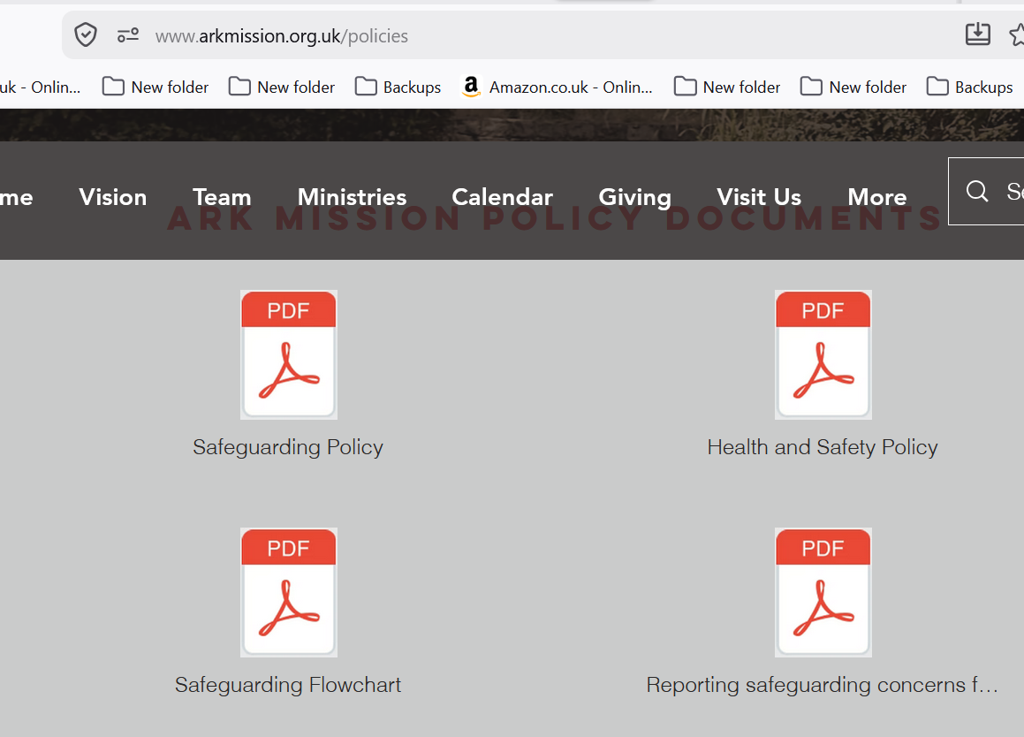
Using the Safeguarding Policy
Purpose of Safeguarding Policy
  The policy provides clarity, consistency, and protection for everyone involved in safeguarding concerns.
Guidance for Leaders
  Leaders should be familiar with the policy and use it as primary guidance when concerns arise.
Consistency and Legal Compliance
  Using the policy consistently helps meet legal obligations and supports effective decision-making.
Policy as Support Tool
  The safeguarding policy is a practical tool that supports ministry, not a barrier to care.
https://www.arkmission.org.uk/policies
Notes:
The safeguarding policy is the church’s agreed framework for responding to concerns. It provides clarity, consistency, and protection for everyone involved. Using the policy ensures that responses are not based on personal judgement or assumptions, but on shared standards and best practice. Leaders are expected to be familiar with the policy and to use it as their primary guidance when concerns arise. Consistent use of the policy helps the church meet its legal obligations, supports effective decision-making, and demonstrates a commitment to safeguarding as a core value. The policy should be seen as a practical tool that supports ministry, not as a barrier to care.

Slide 15
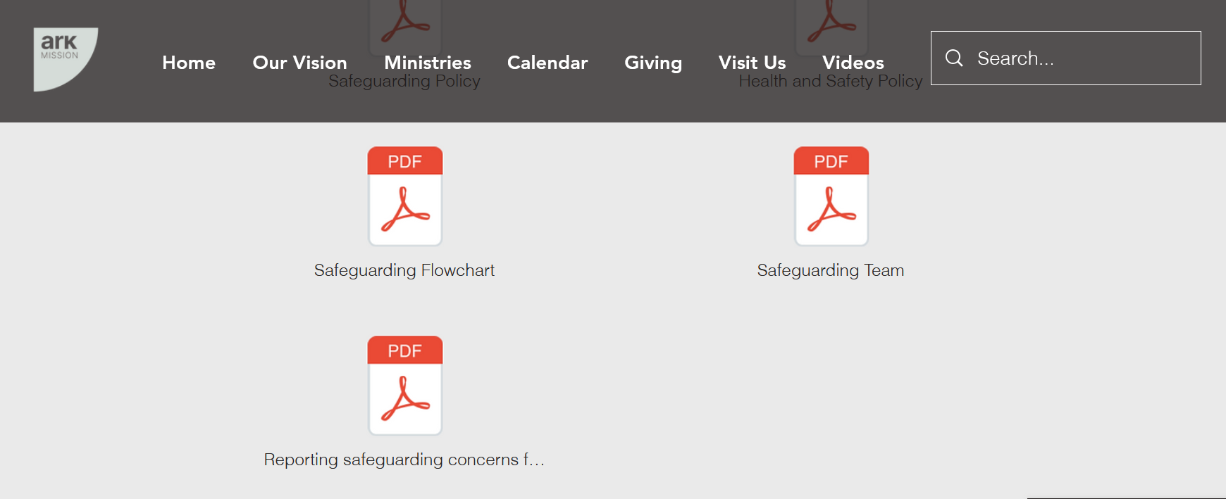
Recognising, Reporting and Recording SG Concerns
Record known ‘when, where, what, why and how’ of the
Disclosure – in note form within an hour
Don’t investigate
Keep confidentiality where possible
Add historic concerns or observations
Facts NOT opinion
Safeguarding reporting form
https://thearkmissionchurch.churchsuite.com/forms/onppqpkw
Find the form in:
https://www.arkmission.org.uk/policies

Slide 16
What to do if you have concerns about a child’s or an adult’s welfare
Child under 18 year of age
Contact SG Lead or Deputy Lead as soon as possible
Fill in the Reporting Safeguarding Concerns Form within one hour or as soon as possible
If you are seriously concerned about a child's immediate safety, dial 999.
Adults and vulnerable adults
Contact SG Lead or Deputy Lead as soon as possible
Fill in the Reporting Safeguarding Concerns Form within one hour or as soon as possible
If you are seriously concerned about a child's immediate safety, dial 999.

Slide 17
Summary: What Do I Do Now?
Keep Updated with the Key Documents:
Know your Safeguarding Team
Know Ark Code of Conduct
Know Ark Safeguarding Policy
When Planning Events:
Read Categorisation of Church Events
Read Guidelines of reporting SG Concerns
Recognise Types of Harm
Know How to Find SG Reporting Form
Safeguarding documents:
https://www.arkmission.org.uk/policies

Slide 18
Wrap-up
Key points: How can you and your team contribute to a safe culture within the Ark?
Check points: Can you remember key agenda points?
Any questions?
Next: Quarterly Safeguarding briefings

Slide 19
Scenario 1: Keep This Between Us
A young person says they feel unsafe at home but asks you not to tell anyone.
Questions:
Is this safeguarding or pastoral?
What should you do?

Slide 20
Scenario 2: Difficult Relationship
An adult describes being controlled and isolated by their partner.
Questions:
What risks are present?
Is this safeguarding?

Slide 21
Scenario 3: Concern About a Volunteer
A parent raises concern about a volunteer being overly physical with children.
Questions:
Should this be reported?
Should you investigate?

Slide 22
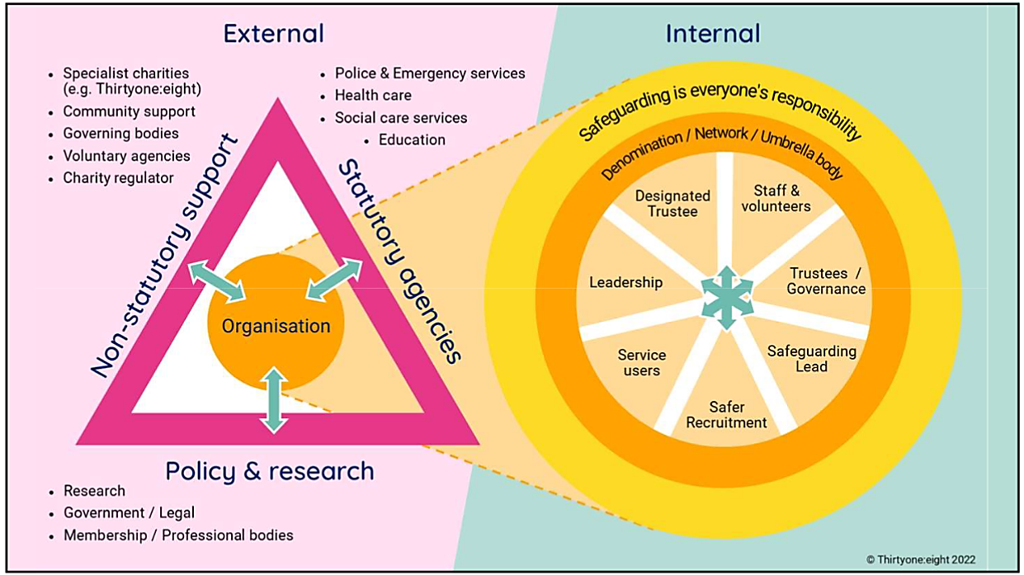
Safeguarding infographic

Slide 23
Summary of Training
List important points from each lesson.
Provide resources for more information on subject.
  List resources on this slide.
  Provide handouts with additional resource material.

Slide 24
Assessment and Evaluation
Prepare a quiz or challenge to assess how much information participants learned.
Survey participants to see if they found the training beneficial.

